Slide 1
Forms
Front-End Web Development

Slide 2
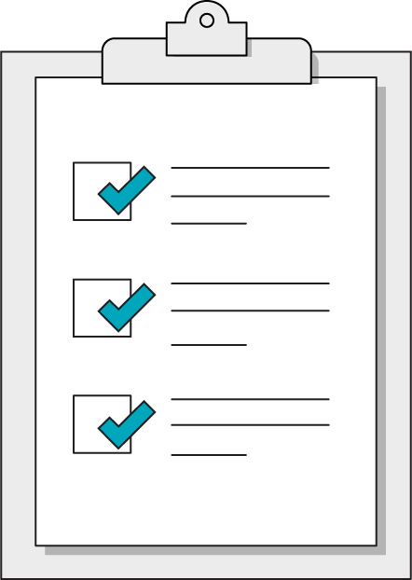
Today’s Learning Objectives
In this lesson, you will:
Use HTML forms to collect input from users.
Respond to form submission events to perform validation checks.
‹#› | © 2020 General Assembly

Slide 3
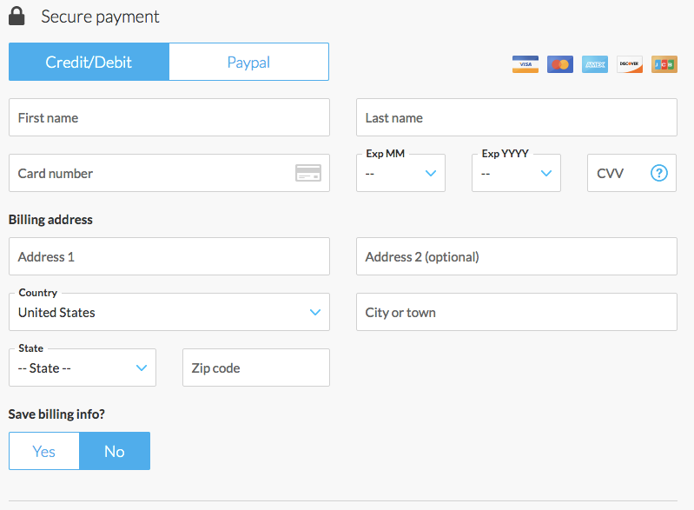
Websites Take on Many Forms...

Slide 4

What Forms Do
Forms capture user input from the web and typically send it off to the back-end of a website to be processed in some way.
Anytime you enter any content into a webpage, you are using a form!

Slide 5
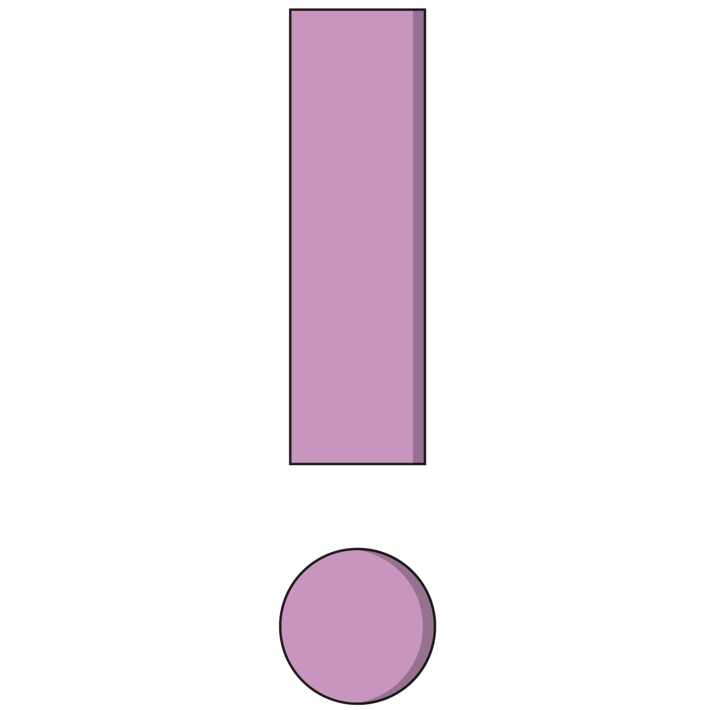
Simplest Form
<form action="/process.php" method="get">
<input type="text">
<input type="submit">
</form>
All forms have the form tag wrapping around them. Always include all components of your form within these tags.
Forms have a lot of markup and are tedious to build.

Slide 6
The Form Element
<form action="/process.php" method="get">
<input type="text">
<input type="submit">
</form>
Action
The action is where the data of the form will be sent (assuming JavaScript is not involved)
Method
This is either “get” or “post” and governs how the browser sends the data to the target listed in the action.

Slide 7
<input>
<form action="/process.php" method="get">
<fieldset>
<legend>Form Title</legend>
<input type="text" id="username">
<input type=”number” id=”age”>
<input type=”submit” value=”Submit this form!”>
</fieldset>
</form>

Slide 8
<label>
<form action="/process.php" method="get">
<fieldset>
<legend>Form Title</legend>
<label for="username">Username:</label>
<input type="text" id="username">
<button type="submit">
</fieldset>
</form>

Slide 9
Ready, <fieldset>, Go!
<form action="/process.php" method="get">
<fieldset>
<input type="text">
<button type="submit">
</fieldset>
</form>

Slide 10
Life of a <legend>
<form action="/process.php" method="get">
<fieldset>
<legend>Form Title</legend>
<input type="text">
<button type="submit">
</fieldset>
</form>

Slide 11
Types of Inputs
Front-End Web Development

Slide 12

The Wide, Wide World of Input Types
There’s a huge list of possible input types out there: https://developer.mozilla.org/en-US/docs/Web/HTML/Element/input
Depending on how specific you want to get, the same form question could be represented with several different form inputs.
Once again, the world of programming presents us with a large number of possibilities. Like usual, we’ll focus in on a few of the most important items that will allow us to master the patterns that will show up for all other types of inputs.

Slide 13
text and number Inputs
<form>
<fieldset>
<legend>Form Title</legend>
<input type="text" id="username">
<input type="number" id="age">
<input type="submit" value="Submit this form!">
</fieldset>
</form>
Data gathered with JavaScript from a number input will be in the form of a string! You may have to typecast the value into a number type.

Slide 14
<textarea>
<textarea placeholder="Write something here"></textarea>
This creates a really big area of text that users can fill in. Although you may see this done in examples, don't size it with HTML attributes — please use CSS!

Slide 15
<select>
<select id="plays-of-shakespeare">
<optgroup label="Dramas">
<option value=”king-lear”>King Lear</option>
<option value=”hamlet”>Hamlet</option>
</optgroup>
<optgroup label="Comedy">
<option value=”midsummer”>A Midsummer Night’s Dream</option>
<option value=”twelfth-night”>Twelfth Night</option>
</optgroup>
</select>
select is for lists you click on to select an item.
optgroup is optional but useful for grouping related options.
option is an individual value a user can choose from the select list.

Slide 16
Checkboxes
<div class="checkbox">
<input type="checkbox" id="vip-upgrade">
<label for="vip-upgrade">VIP upgrade</label>
</div>
checkbox inputs can either be “on” or “off,” depending on whether the user has clicked them.
You have to put labels after checkboxes for them to make any sense, otherwise they’re just floating squares in your form.

Slide 17
Radio Buttons
<div class="radio">
<input type="radio" id="radio1" name="quality-feedback">
<label for="radio1"><span>Good</span></label>
</div>
<div class="radio">
<input type="radio" id="radio2" name="quality-feedback">
<label for="radio2"><span>Bad</span></label>
</div>
Radio buttons are very similar to checkboxes but function as a group with the name attribute. Users can only choose one option among radio inputs with the same name.

Slide 18
Styling Forms
Front-End Web Development

Slide 19
New CSS Selector: Attributes
input[type=text] {
margin: 25px 0;
}
input[type="text"] {
margin: 25px 0;
}

Slide 20
:focus
textarea:focus {
outline: none;
}
There may be cases where you want to style what it looks like when a user is active on a field. To do so, use the :focus pseudo-selector.

Slide 21

Styling Notes
Don’t
Do
Style the text boxes, checkboxes, and radio buttons themselves. You can do this, but the techniques will drive you crazy.
Clutter the form with too many images or animations. Forms are supposed to make interactions with web applications simple and clear.
Put effort into styling valid vs. invalid form submission states. Help your users by clearly communicating when a form is invalid and which fields need to be fixed.

Slide 22
Building & Styling A Form
Let’s use this form as an example for responding to a form submission:
Reference code:
https://drive.google.com/drive/folders/13zp3iDPROk1ZRfq6yOYxeKxnFxfFikeG?usp=sharing
‹#› | © 2020 General Assembly

Slide 23
Forms & Frameworks
Front-End Web Development

Slide 24
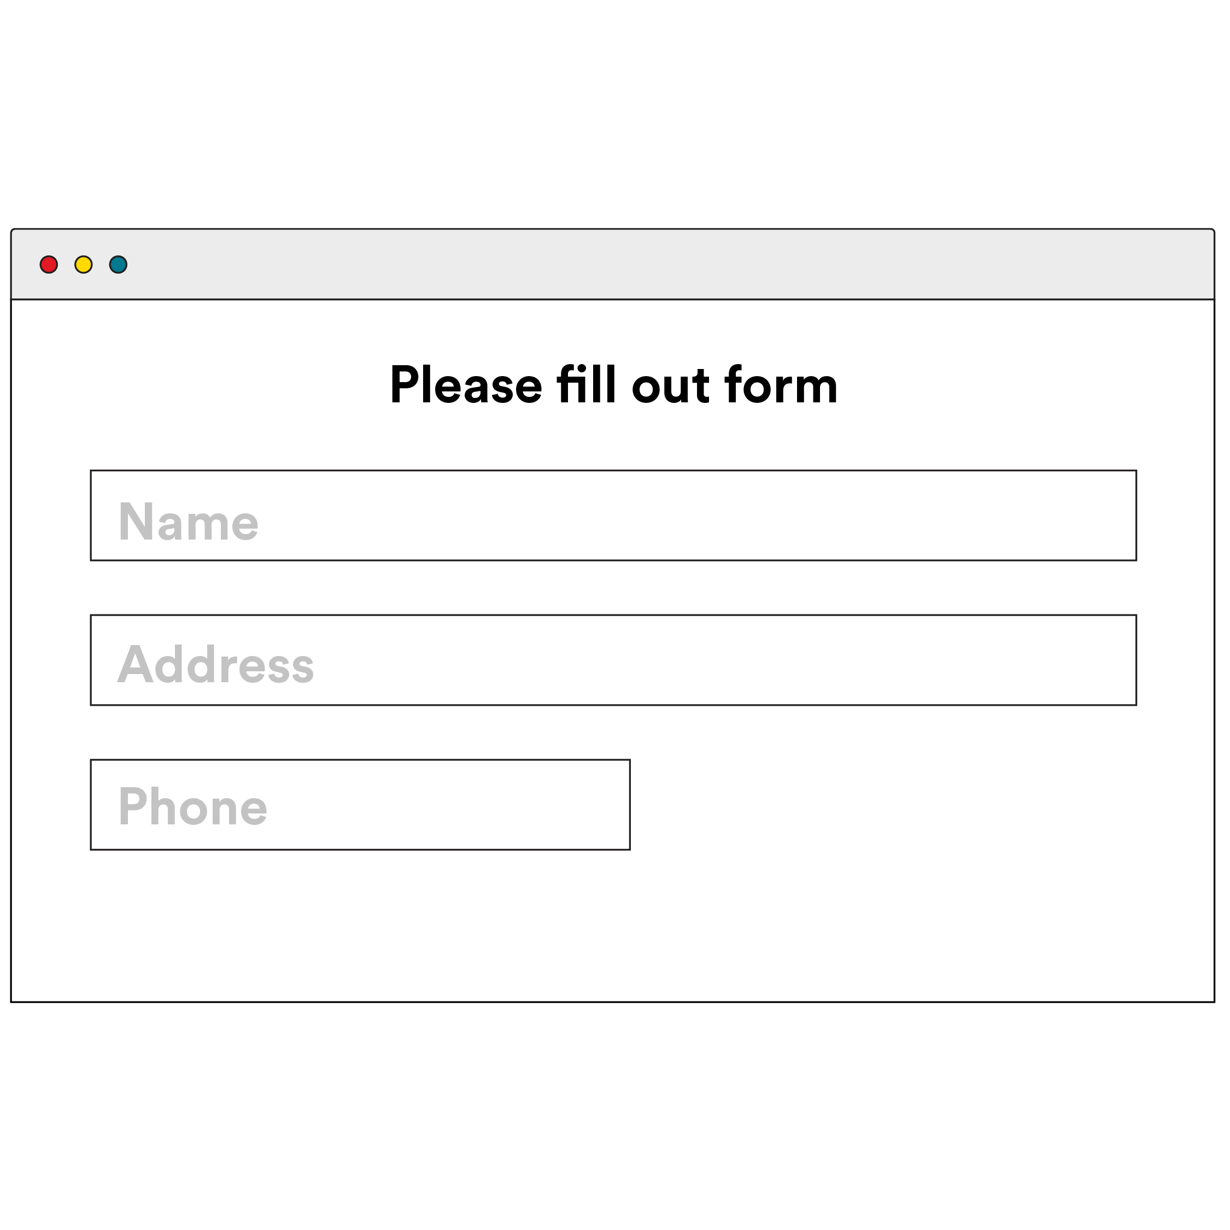
Frameworks Make Forms Easier
Frameworks provide:
Pre-styled form elements.
Better layout combinations
Small style helpers
Responsive form layout
‹#› | © 2020 General Assembly

Slide 25
Forms with Bootstrap
Let’s use this form as an example for responding to a form submission:
Reference code:
https://drive.google.com/drive/folders/15FkHZP8sQSNj09BqAKJNm9Ef_RzkhJwW?usp=sharing
‹#› | © 2020 General Assembly

Slide 26
Validating Form Submissions
Front-End Web Development

Slide 27
Responding to Form Submissions
Let’s use this form as an example for responding to a form submission:
Reference code:
https://codepen.io/GAmarketing/pen/GRgvqOM
‹#› | © 2020 General Assembly

Slide 28
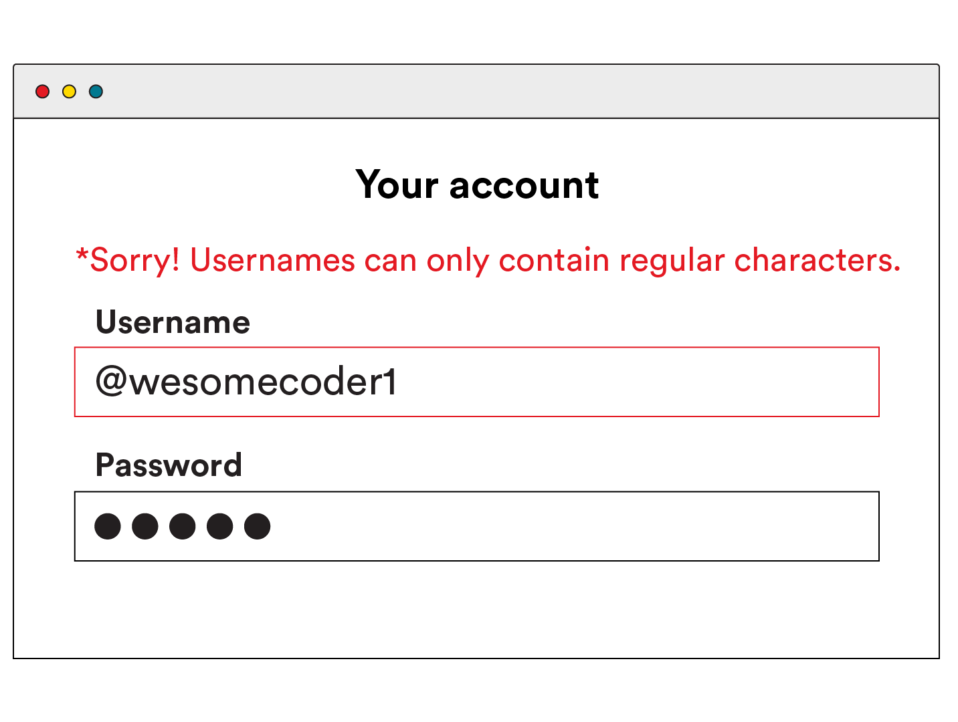
Validating Form Submissions
We’re going to break down how this happens in the next few slides by:
Responding to the “submit” event from a form.
Using the DOM to access the value a user has typed into an input.
Using DOM manipulation to add error messages to the page.

Slide 29
Responding to the submit Event
Remember, nearly any user action triggers an event from the DOM. It’s up to us to attach a listener to the specific DOM element that fires off the event. Let’s grab that element from the DOM and use the addEventListener() method:
document.getElementById(“#registrationForm”).addEventListener(“submit”,
function(event){
// event.preventDefault() prevents the browser from refreshing
event.preventDefault();
}
);

Slide 30
Reading the Form Content
We can use the .value getter method to access the value of an input field...
document.getElementById(“#registrationUserName”).value
...then, we can test that value for anything we want!
if(username.length < 3){
// Show an error message on the DOM
}

Slide 31

Displaying Error Messages
Think about most error messages you’ve seen from forms. Chances are they were displayed close to the input with the invalid value or beneath the form itself, if the problem was more general. You can do this several ways:
You could have an empty, hidden element for errors that gets shown or filled in once the error occurs.
You could append a new element to the DOM then remove it upon resubmission of the form.
You could use an alert box — though this is a bit old fashioned.

Slide 32
Key Takeaways
For Next Time
Forms Power User Interaction
APIs
Forms have many types of inputs.
CSS attribute selectors can target specific types of inputs.
We can respond to form submissions using event listeners.
We’ll use forms to collect data from users and use that data to make requests to other servers.
Our apps will finally interact with other members of the internet community: APIs!
‹#› | © 2020 General Assembly

